Slide 1
Retail

Slide 2
Contents
For each scenario:
Scenario Vision
Primary Persona
Scenario Storyboard
Solution Design Best Practices
Solution Architecture
Scenarios
Customer Assistance – Informed Associate Retail FLW intelligent KM experience
Reserve Inventory Inter-store collaboration experience
Virtual Consult Enhanced Customer Support

Slide 3
Customer Assistance – Informed Associate
Retail Book of Dreams

Slide 4


Scenario Vision
Store Associate
Context
Rachel, a customer of Northwind retail chain, wants to buy home entertainment system for her newly constructed house.
Rachel has basic understanding of home entertainment options and is at the retail store to get a closer look at the different options, understand and compare features and prices and buy a system that matches her requirements.
Current State
When Rachel enters the retail chain, she either sees a static notice board to recognize aisles / sections in the store or asks an associate nearby to find the section for home theaters
On reaching right section, Rachel waits to be assisted and calls upon help from a nearby associate who in turn asks about her requirement and needs
After learning about Rachel’s requirements, store associate finds right associate who is an expert in home theater options and is available for assisting
The expert then takes Rachel on a tour of available options, pitching fast moving products in the store which might or might not match her brand preferences and budget restrictions
The associates also have to keep themselves updated on latest product features, specifications and discounts that are currently running in the store and for each product line.
Future State
When Rachel enters the retail chain, she is greeted by a store associate who talks to her to understand her requirements. The associate then creates a ticket for assisting Rachel.
An available associate sees the requirements and picks it up and can immediately start assisting Rachel. The associate not only knows what Rachel is interested in right now but also has an insight into her prior purchases and preferences
The associate can quickly browse through list of home theater options available at the store which are fast moving and relevant to customer’s preferences.
Along with product details, specifications from centralized knowledge repository, personalized offer and discounts that is authorized for Rachel is also surfaced.
After successfully making a sale, the associate is presented with real time insights on other products frequently sold together encouraging cross selling and upselling
The associate is also provided with an option to capture customer sentiment and satisfaction at the order confirmation
- Points of Friction

Slide 5

Sandra Jones, Retail Customer Assistance Champion
Sandra is an amicable, friendly customer assistance champion in Northridge region store of North Wind Traders electronics retail chain. She is an expert at identifying customer needs and is proficient in handling customer relations.

Slide 6
Customer assistance staff welcomes a regular customer, creates an assistance ticket that can be picked up by available Sales pros

Slide 7
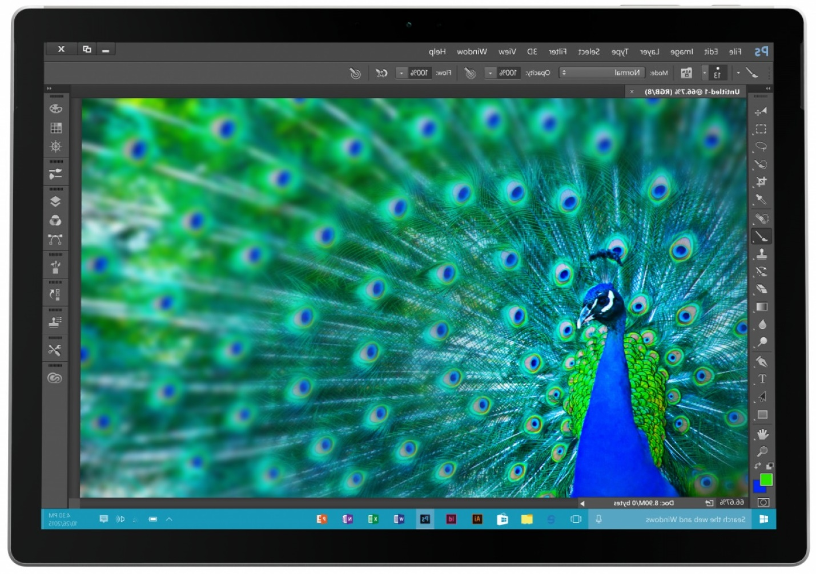
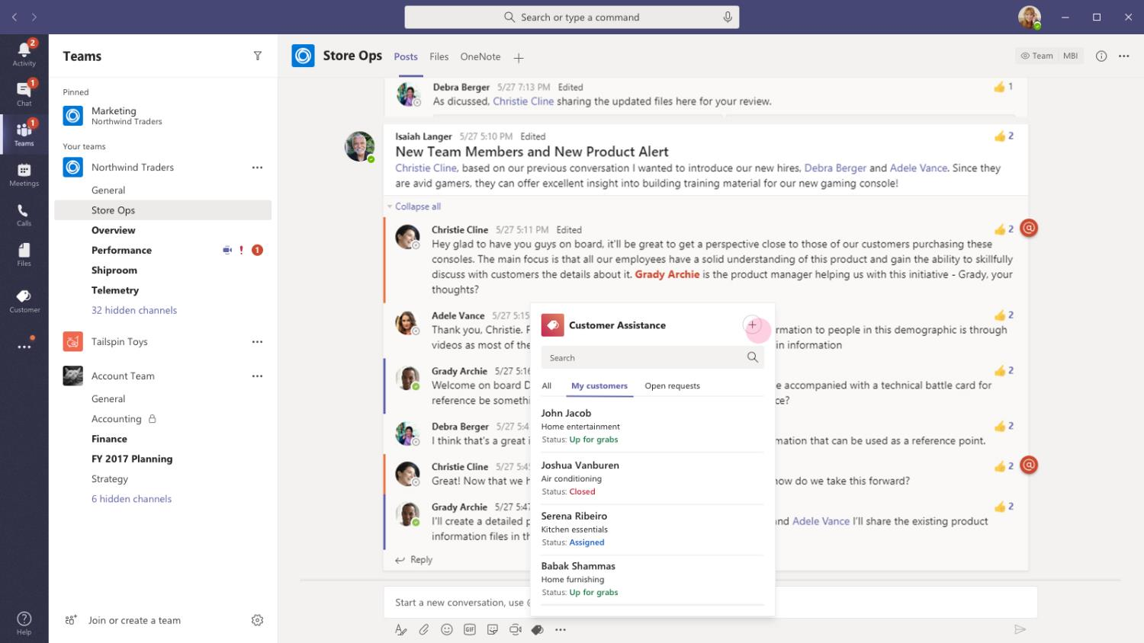


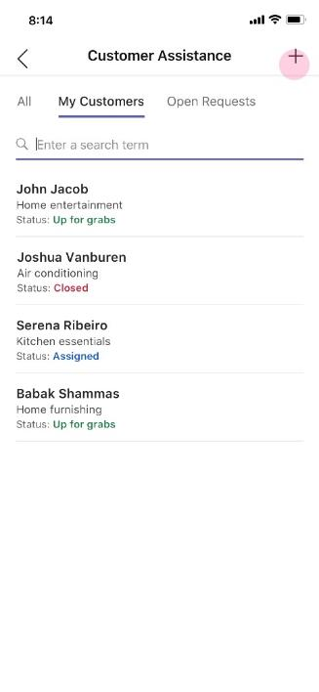
Retail – Informed Customer Assistance
The store staff welcomes a loyal customer back to their store. After talking to the customer, Sandra uses the app’s message extension to create a new customer request

Slide 8
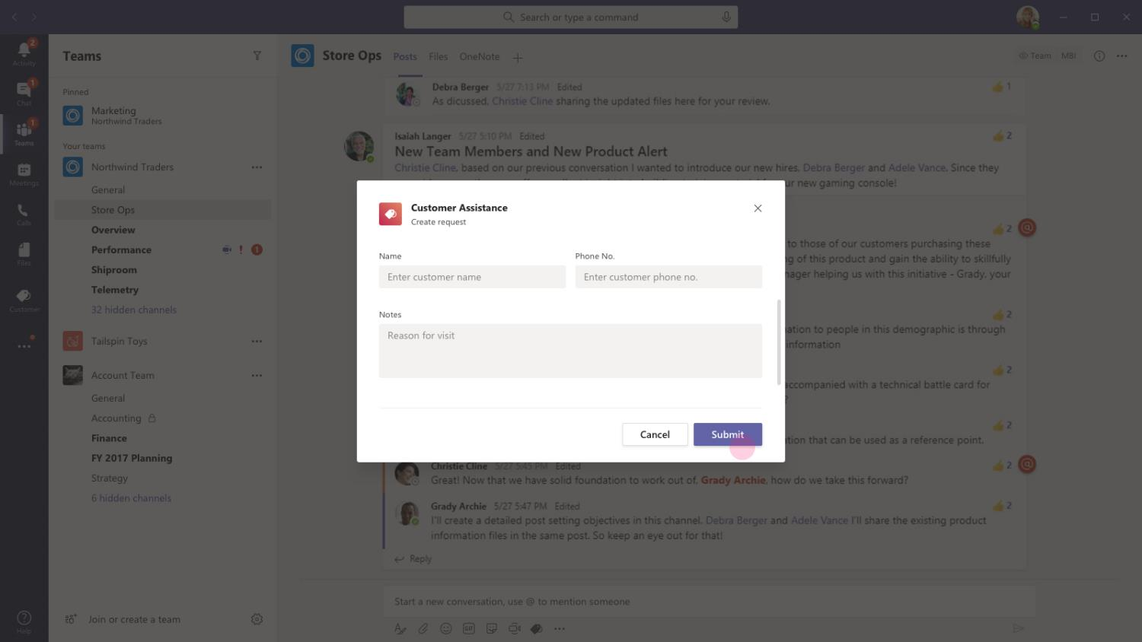

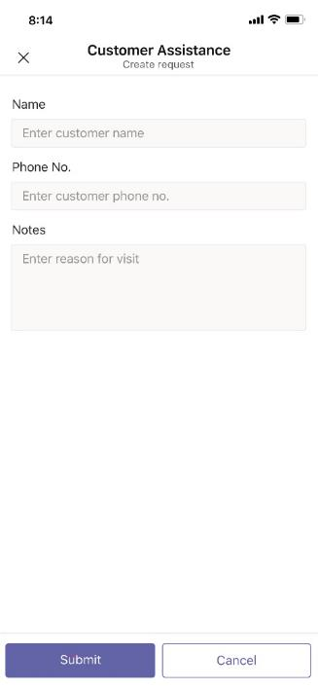
Retail – Informed Customer Assistance
A task module opens that allows Sandra to enter information she gathered from interaction with the customer. This typically includes the reason for visit and if the customer wants to check out any particular product or wants to browse through a section.

Slide 9
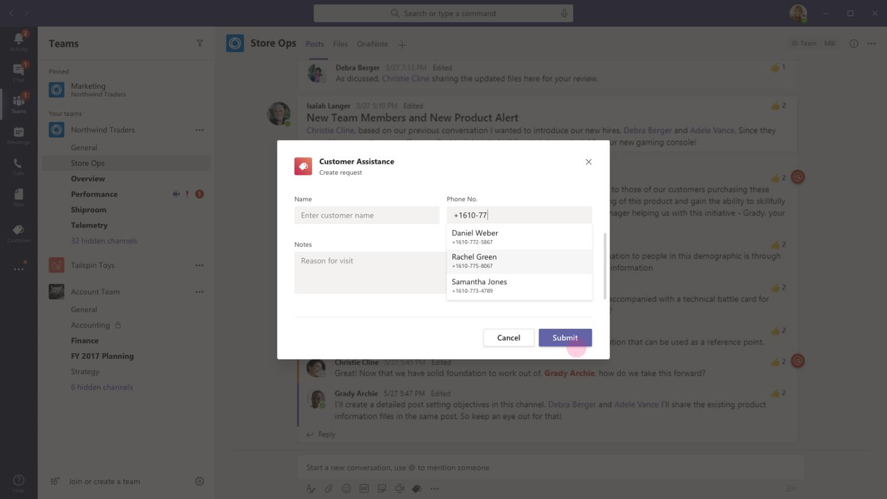
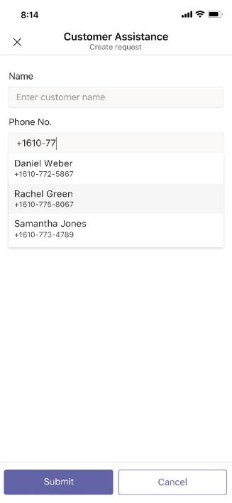
Retail – Informed Customer Assistance
From the task module, Sandra is able to find the customer info from backend CRM database. She enters the mobile number of the customer to locate their profile

Slide 10
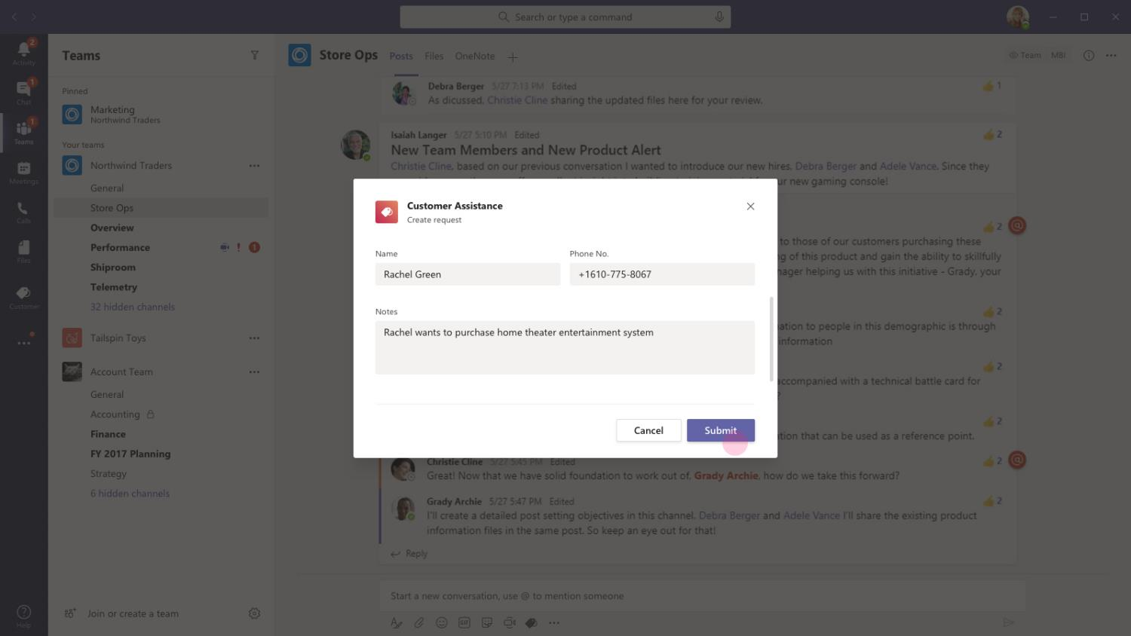
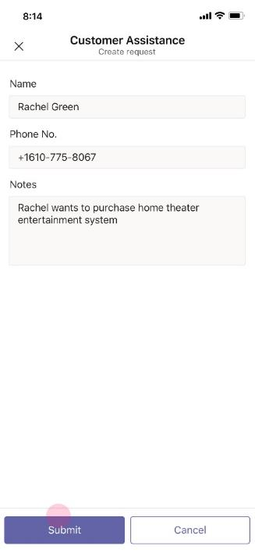
Retail – Informed Customer Assistance
After selecting the customer name / number, Sandra proceeds to note the reason for customer’s visit. She uses this space to clearly communicate to the floor staff on the customer - Rachel’s interests, wants and needs.

Slide 11
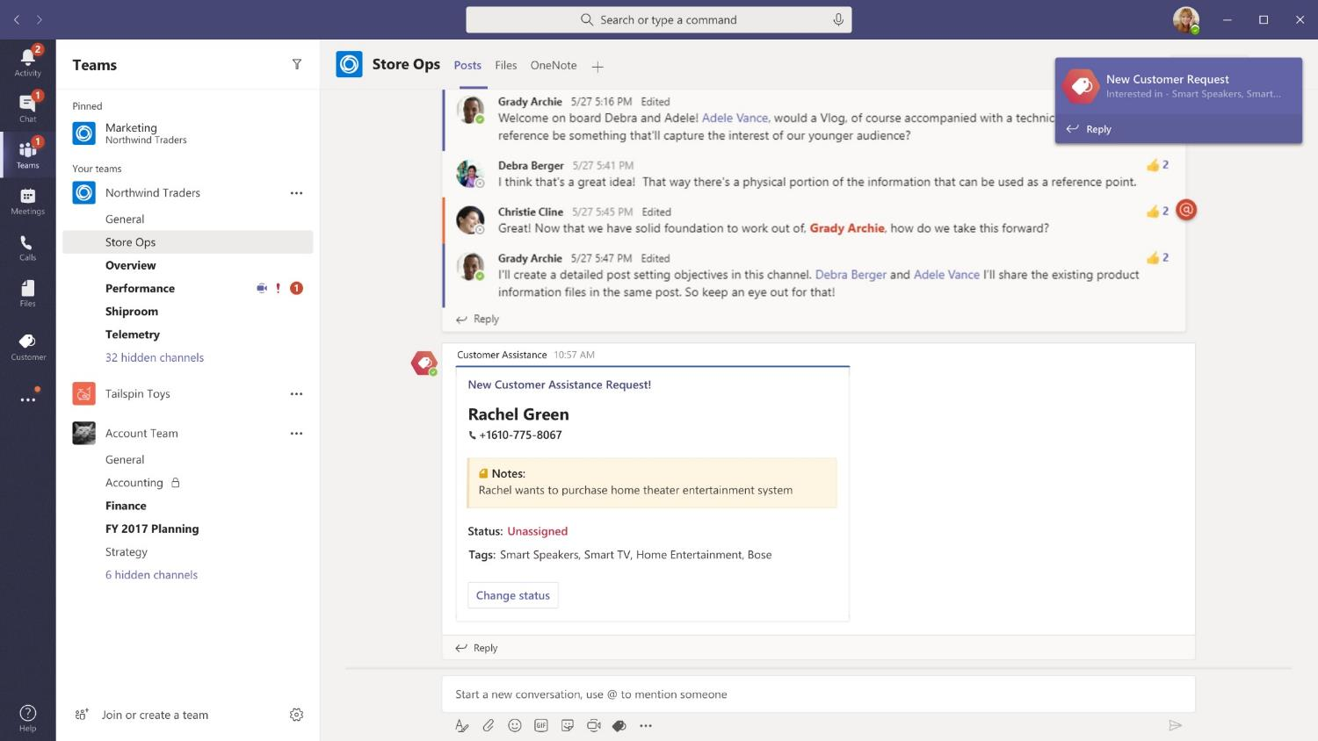
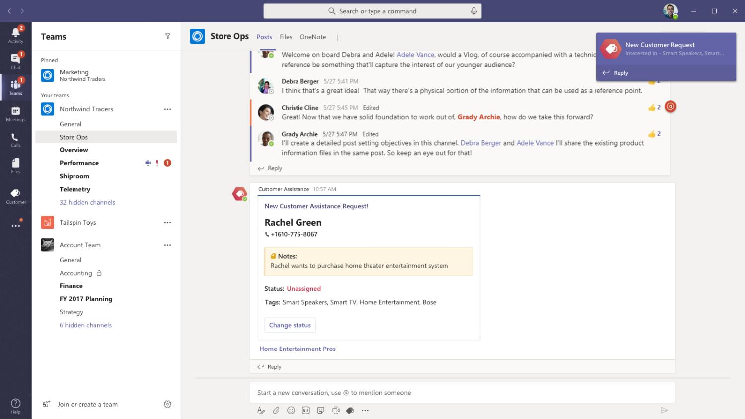

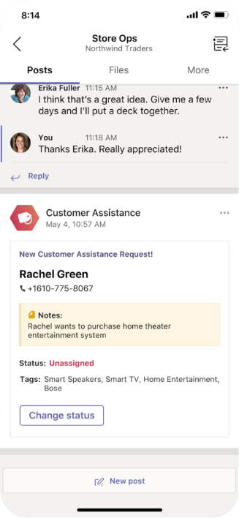
Retail – Informed Customer Assistance
On clicking submit, the new customer assistance request gets posted into designated channel with all retail floor staff. The card provides useful information as tags auto generated from Rachel’s prior purchase behaviour and text from Notes

Slide 12

Roy Howard, Sales Pro
Roy Howard is a sales pro at North Wind Traders electronics retail chain. He is in charge of the Home entertainment, Smart TVs section of the store.

Slide 13
Sales Pros are notified as the message gets posted on the channel and they can start assigning customer assistance request to themselves

Slide 14
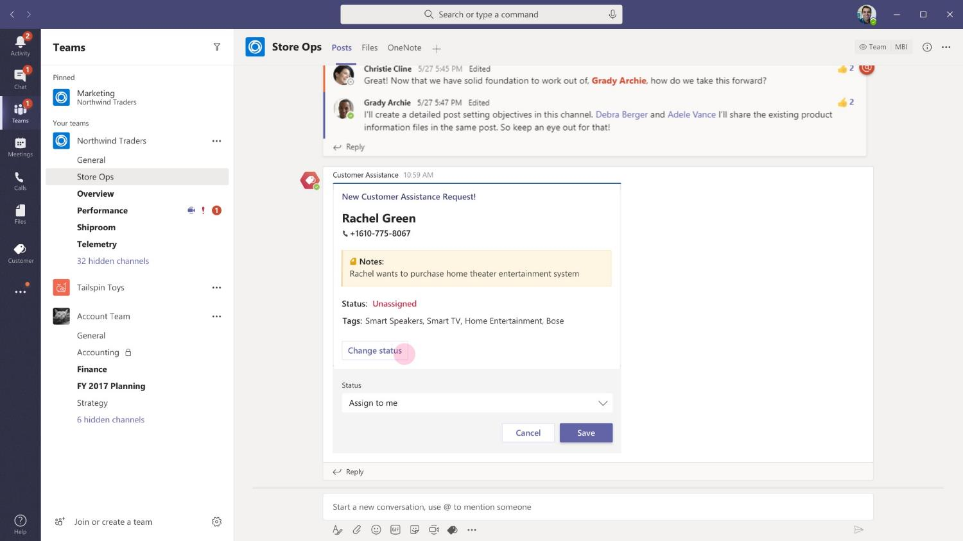
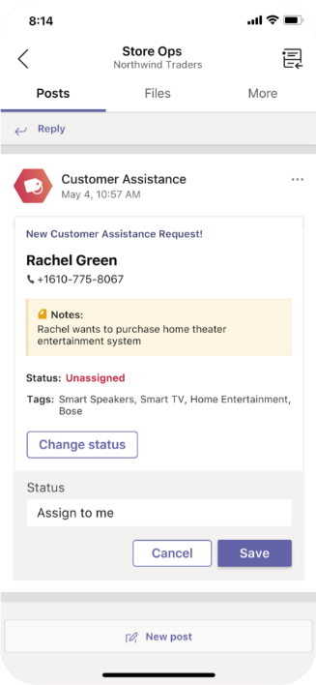
Retail – Informed Customer Assistance
Using the information from tags and availability to assist a customer, the right staff with skillset and experience in Home theatre entertainment systems can choose to assign the request to their name and start interacting with Rachel.

Slide 15
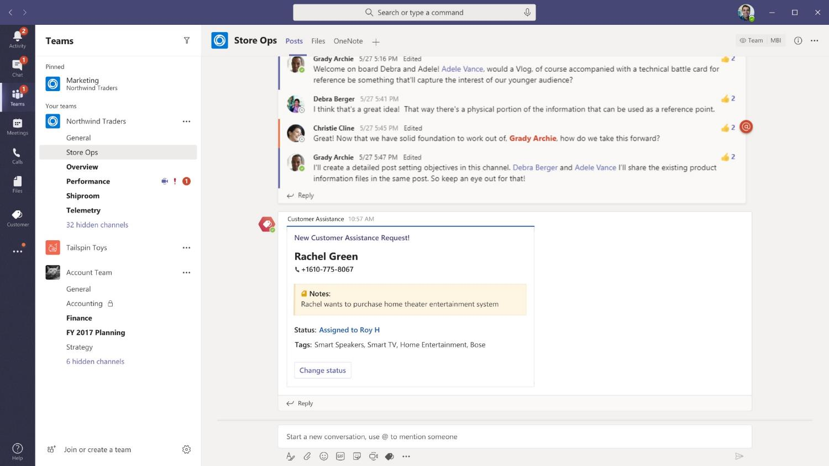
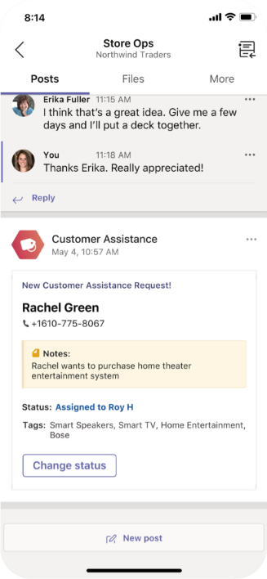
Retail – Informed Customer Assistance
The card refreshes to update and show that Roy Howard is available to assist Rachel in taking her on a tour of home theatre options available at the store

Slide 16
Sales Pros get access to currently available options for Home entertainment system at the store, entire knowledge library of product talk track and customized user discounts and offers

Slide 17
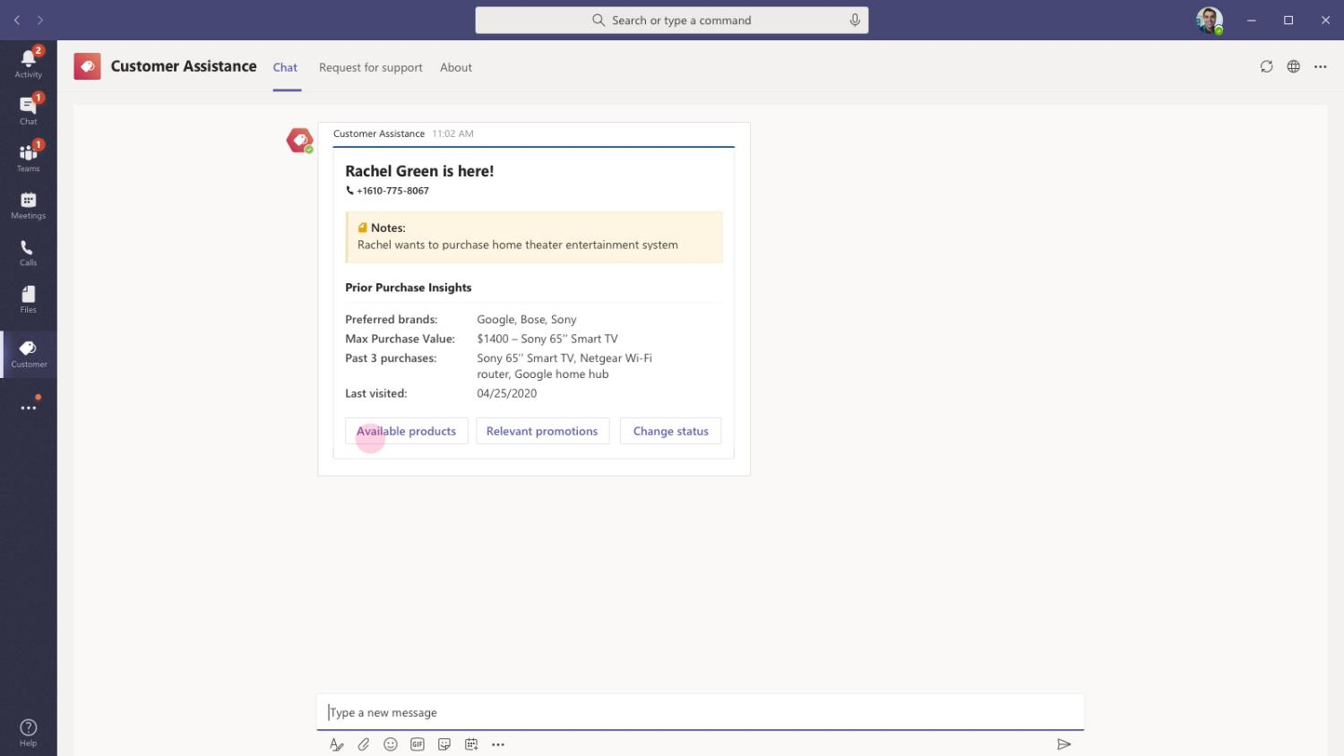
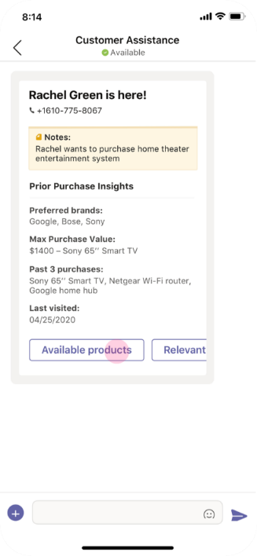
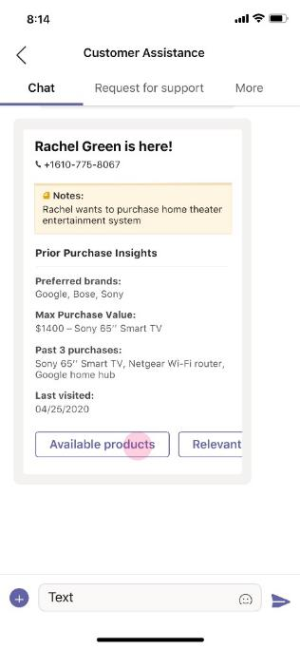
Retail – Informed Customer Assistance
As soon as Roy Howard assigns the request to himself, he gets a card with information about Rachel and her past purchases in the personal scope of the app. Roy can make product suggestions, recommendations armed with this extra info about Rachel

Slide 18
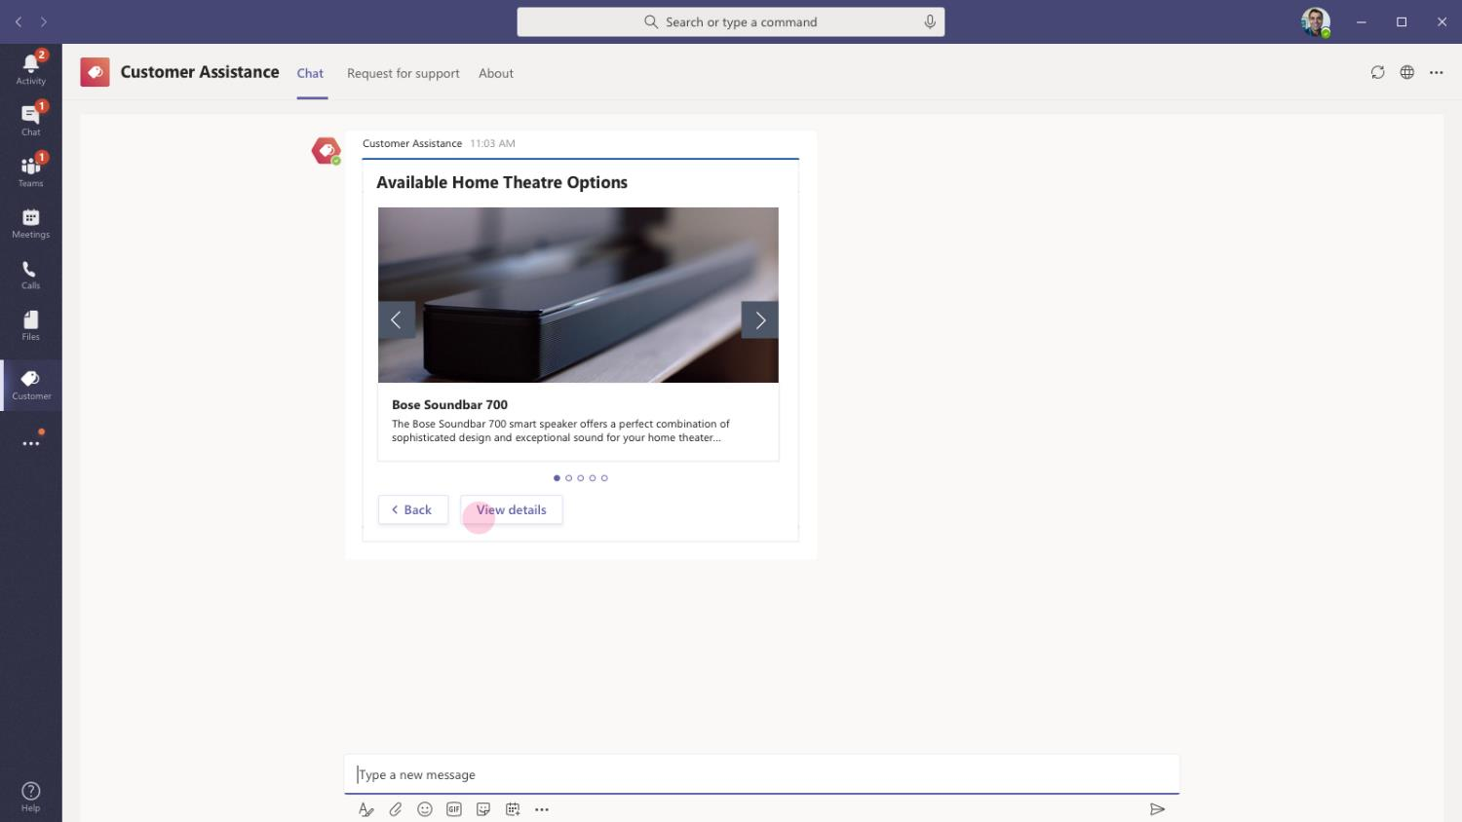
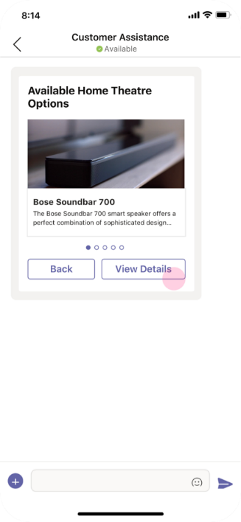
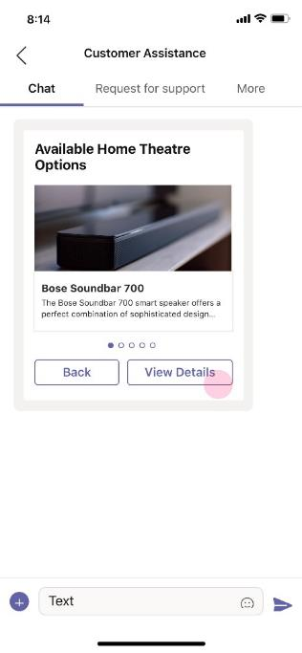
Retail – Informed Customer Assistance
As Roy clicks on Available Products, the card updates to show a carousel of various home theatre products available in stock in the store. This list is sorted based on Rachel’s past purchase and popularity of products in the store.

Slide 19
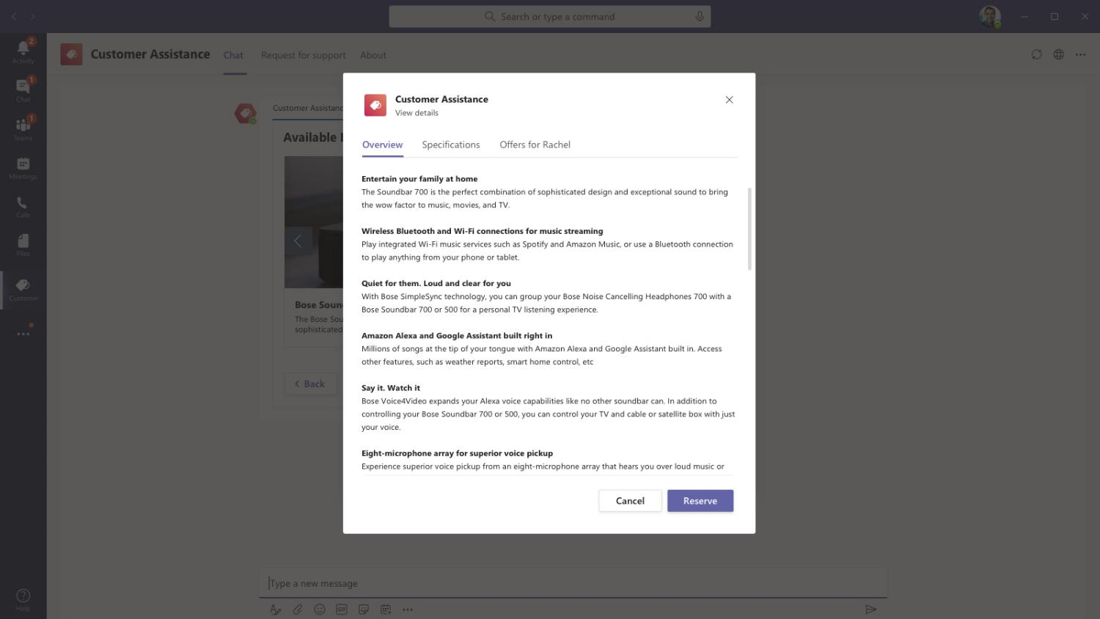
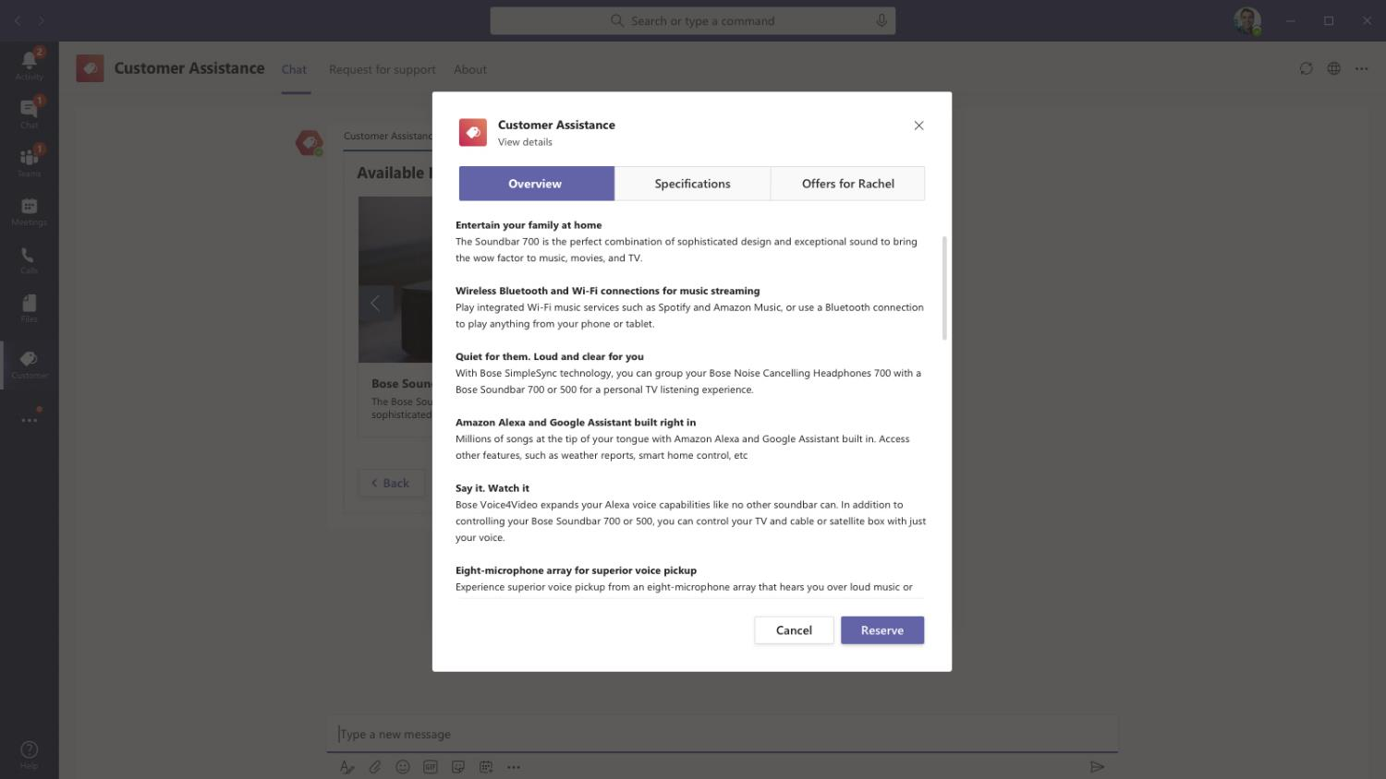
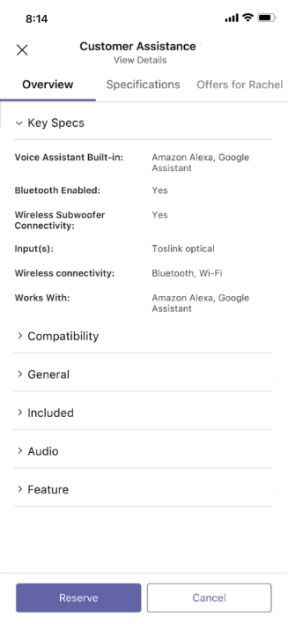
Retail – Informed Customer Assistance
Roy can readily see details of the product, various features and functionalities that might be of interest to Rachel. The information is constantly updated and fetched from backend product database, so that Roy always has latest information

Slide 20
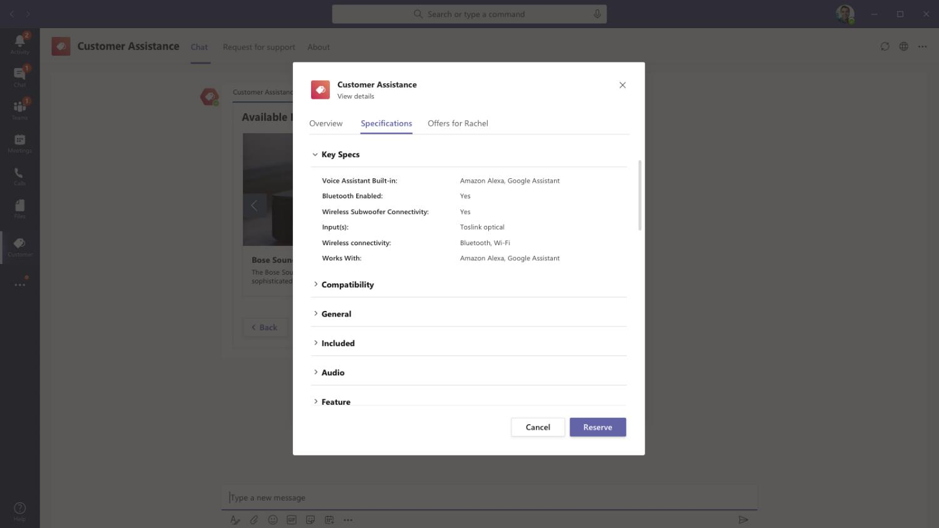
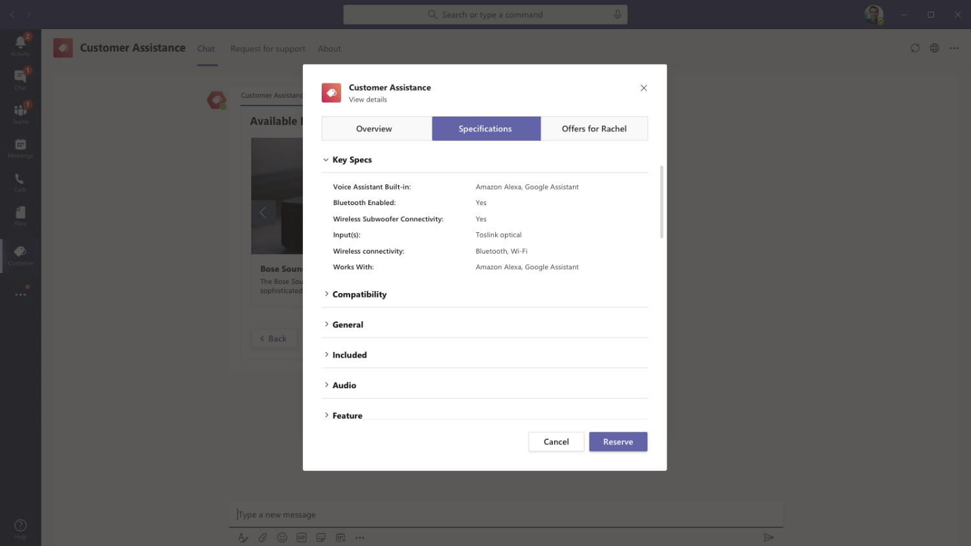
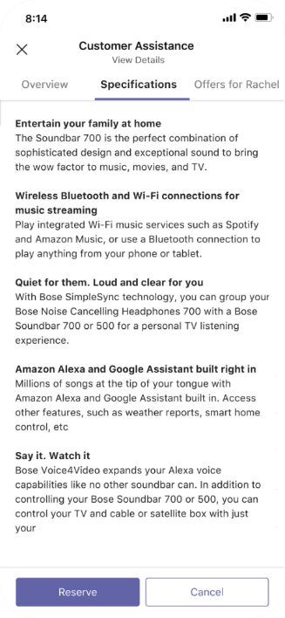
Retail – Informed Customer Assistance
When Rachel asks questions related to a product that interests her, Roy can look at specs and other details for any product and provide accurate answers

Slide 21
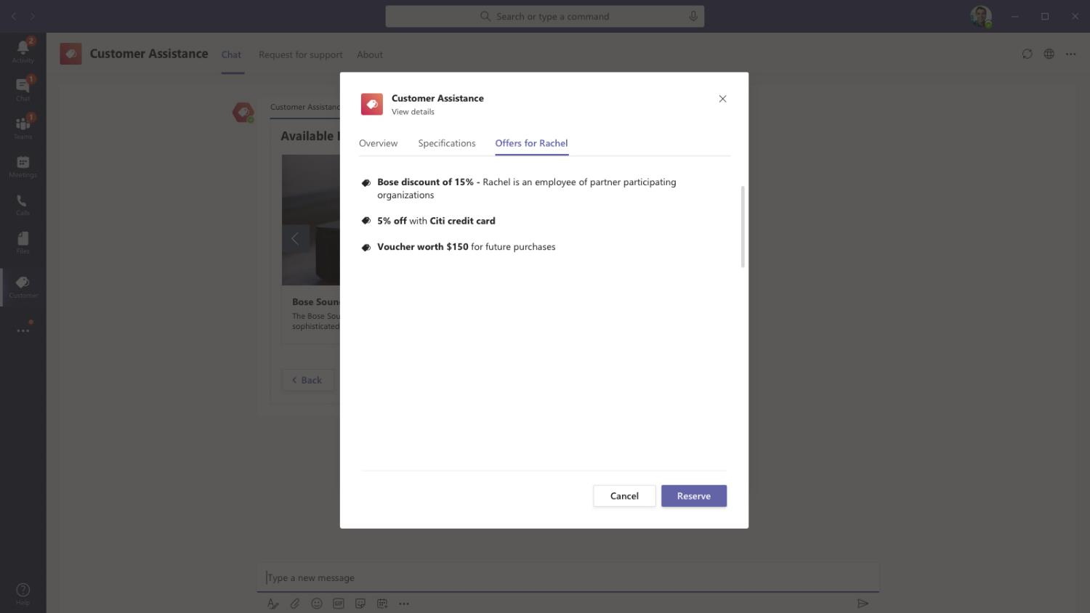
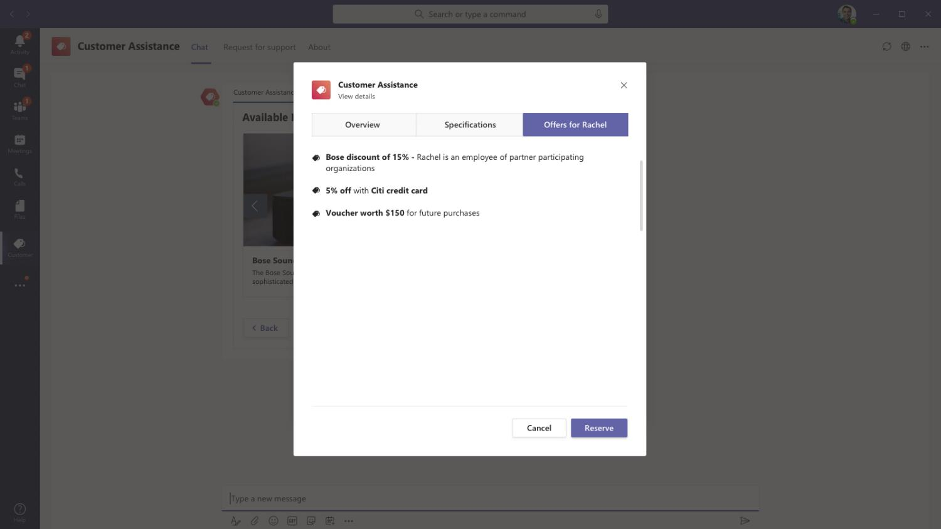
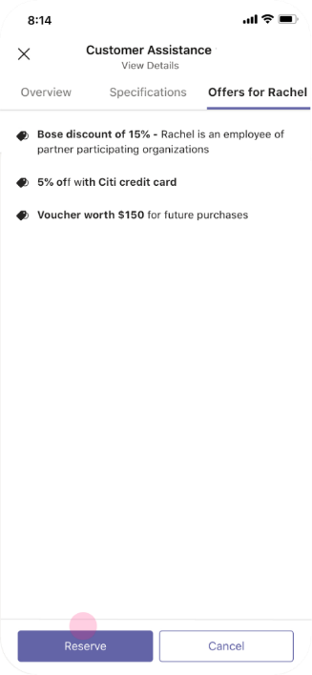
Retail – Informed Customer Assistance
Roy also has access to customized discounts, offers based on customer loyalty that is specifically available for Rachel for this product. Roy is armed with all discount campaigns that are currently running in the store and for each product line

Slide 22
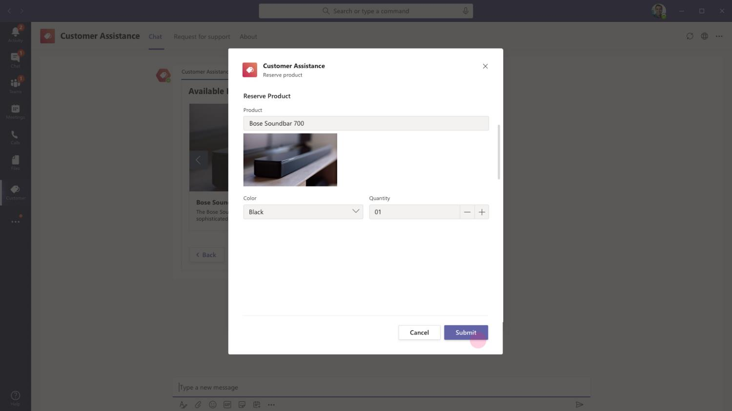
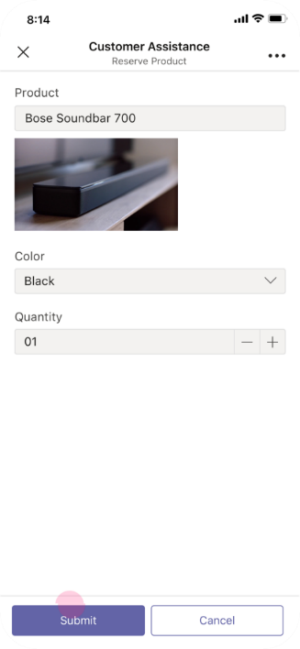
Retail – Informed Customer Assistance
Once Rachel is convinced with the information received and happy with the price, Roy can reserve the product immediately.

Slide 23
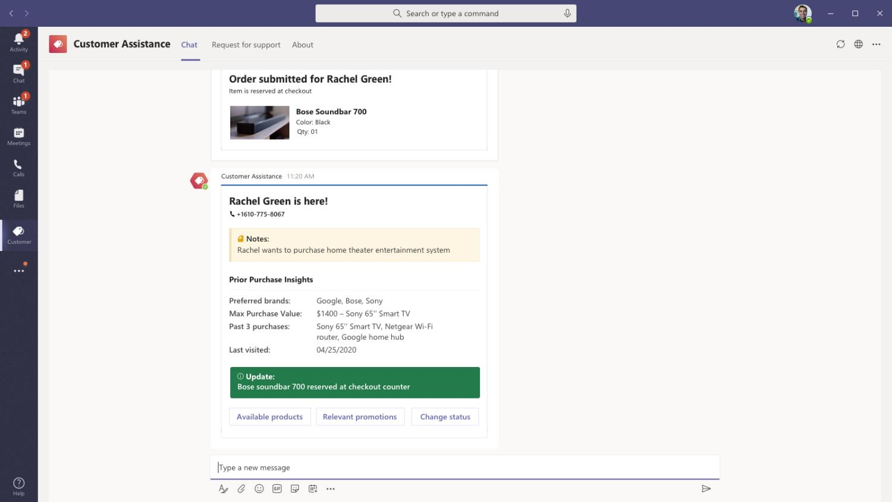
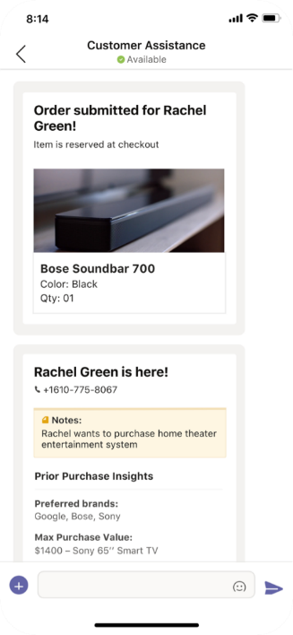
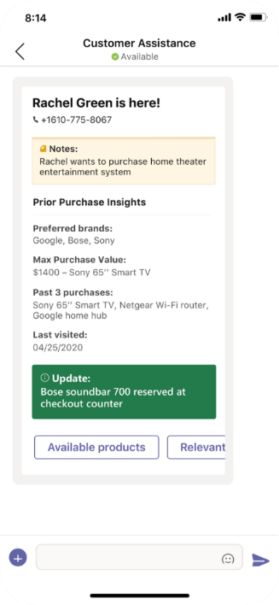
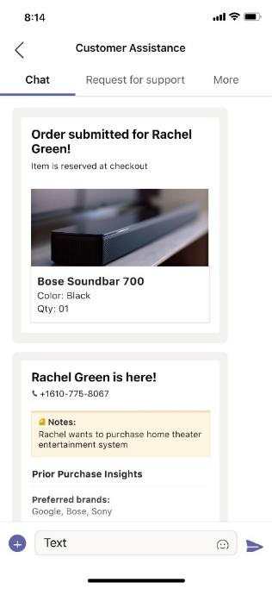
Retail – Informed Customer Assistance
Once reserved, it will be available for Rachel to pick up at the checkout counter.

Slide 24
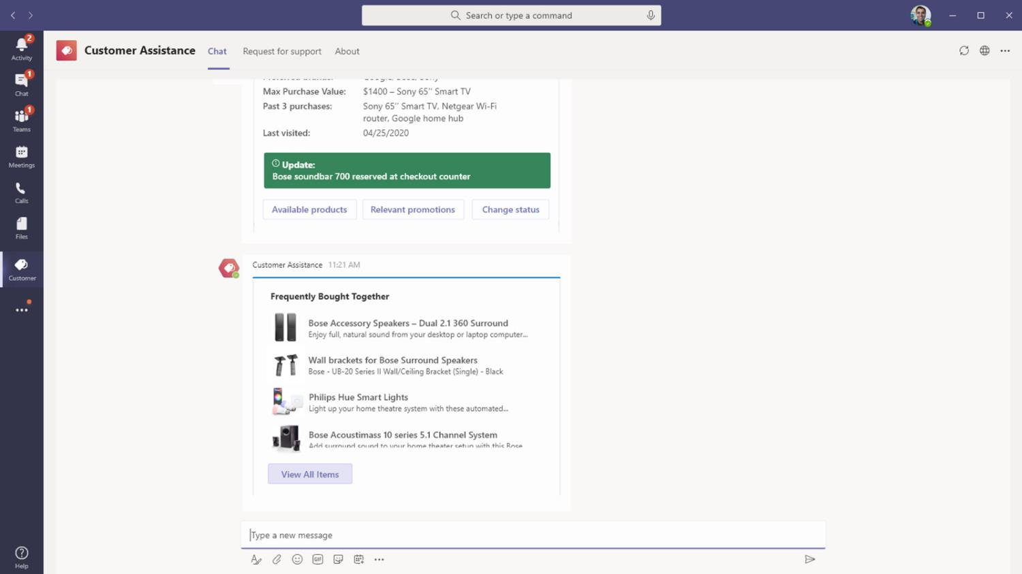
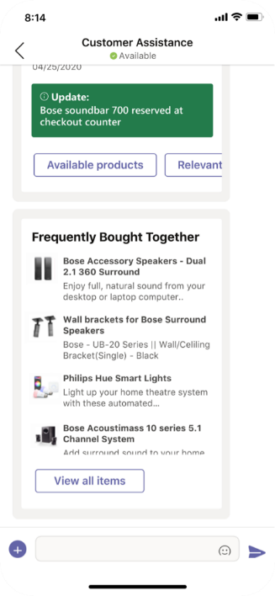
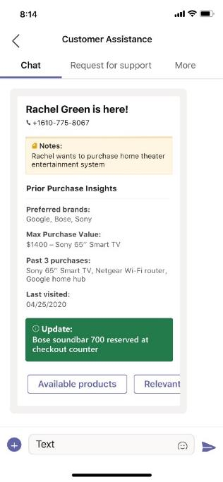
Retail – Informed Customer Assistance
As soon as the product is reserved, the app provides a list of other items that are frequently bought together. This handy list helps Roy to perform upsell or cross sell of other related products in the store

Slide 25
Sales Pros can sell additional items, accessories to go with main sale and redirect the customer to another department to buy more

Slide 26
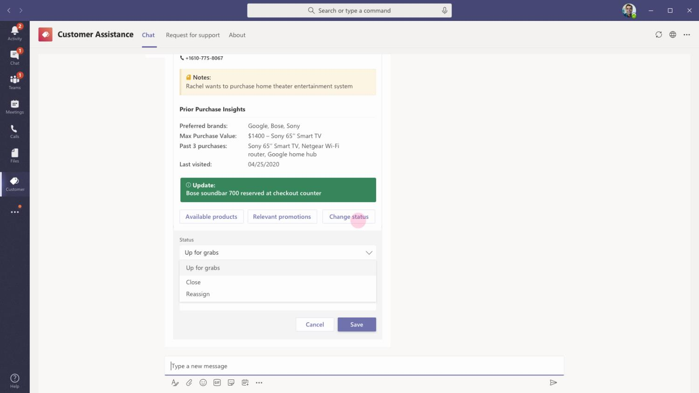
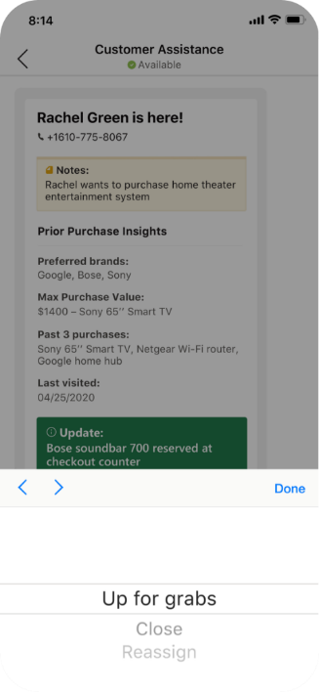

Retail – Informed Customer Assistance
As Rachel is interested in buying a few other items outside Roy’s section, Roy can reuse the same card to send the customer assistance request back to the common pool.

Slide 27
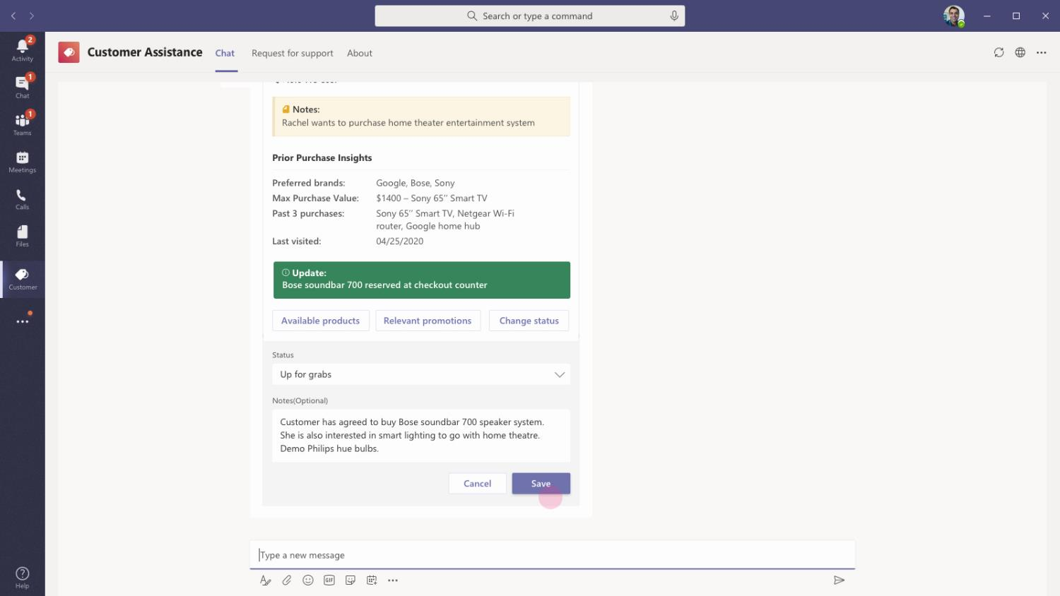
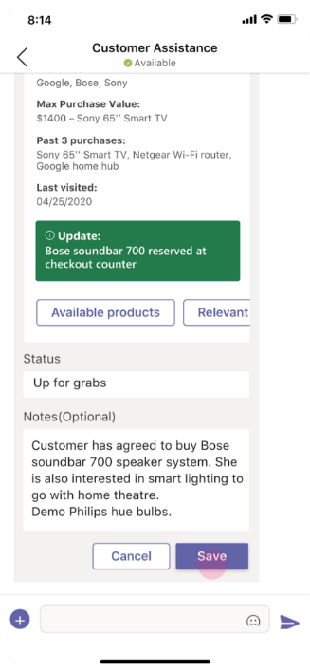
Retail – Informed Customer Assistance
While transferring the customer to another assistance staff, Roy uses the comment box in the card to mention customer’s interest and asks the next assistant to demo smart lighting solutions available at the store

Slide 28
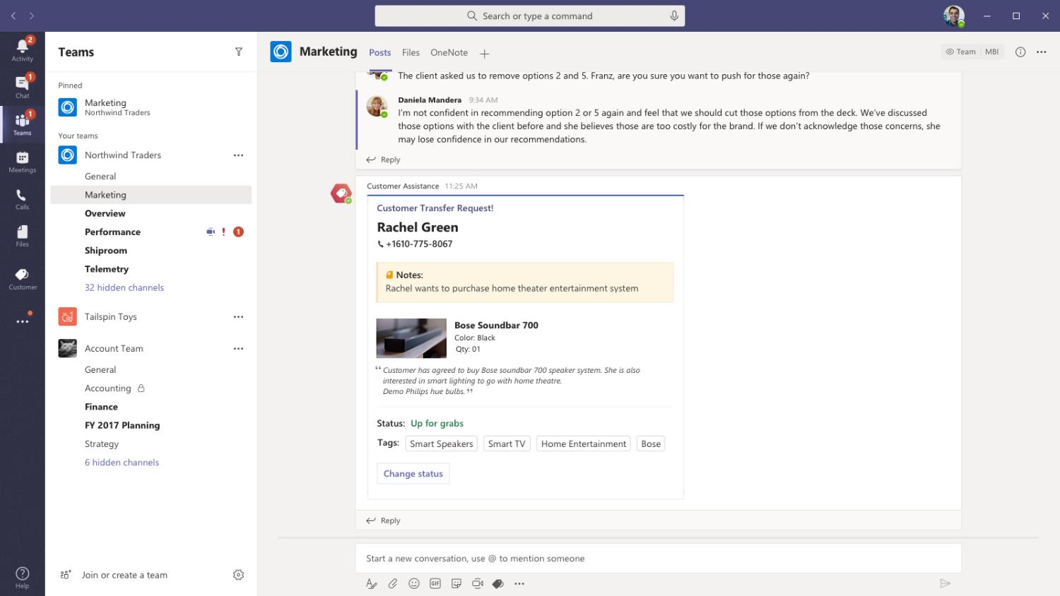

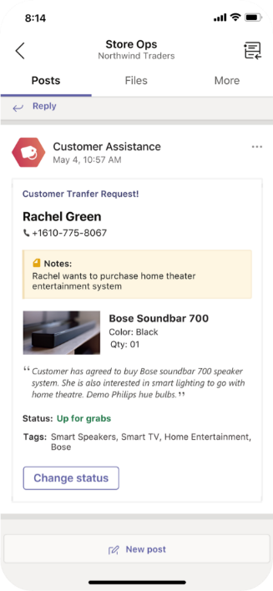
Retail – Informed Customer Assistance
Once Roy marks the card as ‘Up for Grabs’ it is posted again in the common channel used by Floor staff as Customer Transfer Request. The sales staff responsible for Smart Bulbs section can then choose to pick up this customer for the demo

Slide 29
Sales Pros can get instant customer satisfaction survey at the time of sale confirmation to immediately capture the customer experience

Slide 30


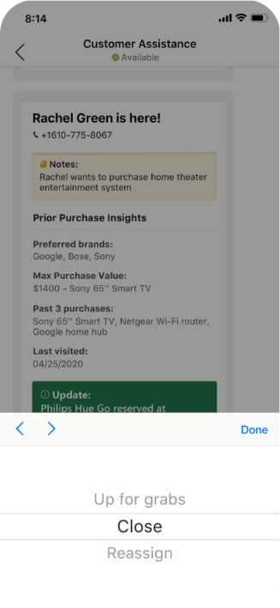
Retail – Informed Customer Assistance
As Rachel completes all purchases in the store, customer assistance staff uses the adaptive card to close the assistance request

Slide 31


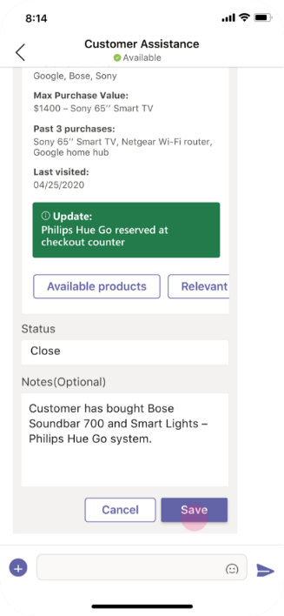
Retail – Informed Customer Assistance
The card provides comment box to log any vital piece of information regarding Rachel’s preferences or closing remarks.

Slide 32
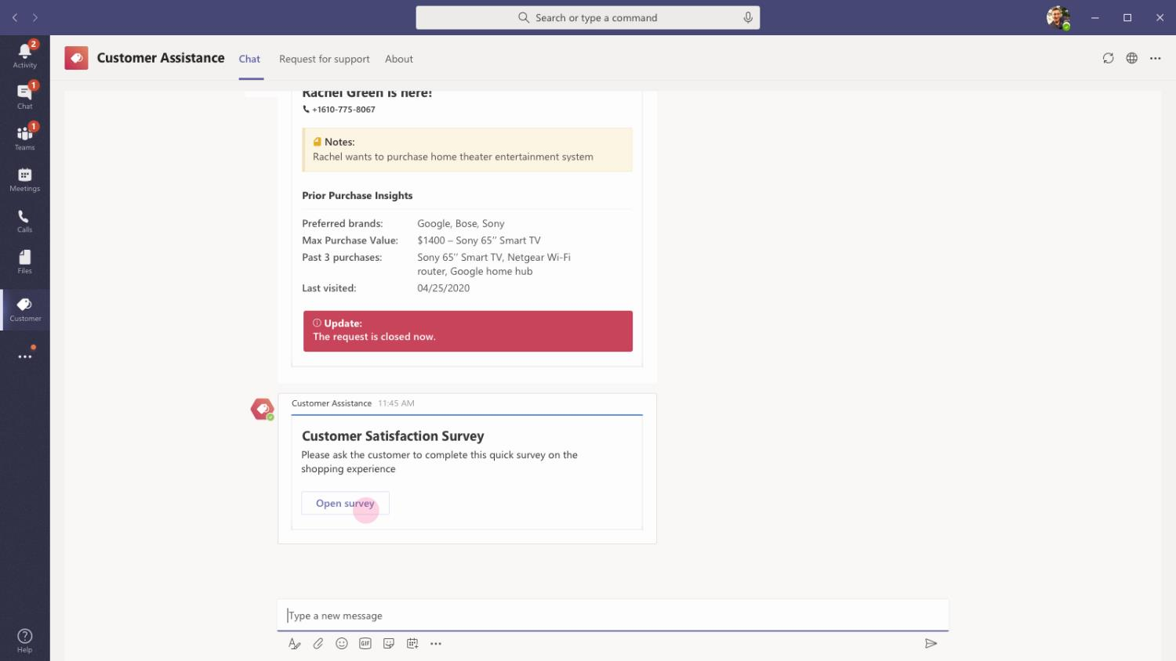

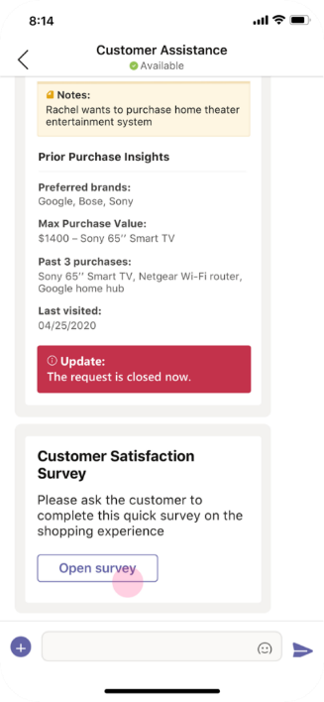
Retail – Informed Customer Assistance
As soon as the request is closed, the assistant who handled Rachel last, gets a customer satisfaction survey request.

Slide 33



Retail – Informed Customer Assistance
The assistant opens the survey request and presents mobile device to Rachel for her to fill out the survey. This accurately captures Rachel’s sentiment and experience at point of purchase.

Slide 34


Retail – Informed Customer Assistance
Will Little, Store Manager
Will Little is the store manager at Northridge region store of North Wind Traders electronics retail chain. He takes care of store operations, manages inventory, and oversees end to end customer care

Slide 35
As soon as a customer purchases the item, the Retail Store Manager gets a low stock alert based on minimum threshold set

Slide 36



Retail – Informed Customer Assistance
The store manager gets an automated notification indicating that one of the products in the store has gone below the threshold limit set by the manager. The manager can then choose to reorder the item to maintain optimal inventory levels.

Slide 37
Solution Highlights – Best Practices
Retail – Informed Customer Assistance
Key Solution Design Considerations
Platform Extension Points
Adaptive Cards
Messaging Extension (ME) is used for triggering new customer requests to enable search, sharing and collaboration of customer assistance cards.
MEs fit this use case better than using, say a bot to raise this request because MEs inherently allow information created to be shared to larger group.
Since customer assistance requests are meant to be shared in a channel full of Sales associates for everyone to collaborate and take decision, ME becomes the ideal platform extension point
Task modules are used for customer satisfaction survey, viewing product details, reserving a product use cases in order to quickly take actions, perform information exchange between associate and backend systems while keeping the associate in the main flow of assisting the customer
The same survey could have been achieved as an adaptive card in the chat screen. However, adaptive cards become persistent messages.
In this case, the sales associate will have no use for viewing the survey card after the customer completes the survey. Hence task modules provide the ideal experience
Card refreshes are used to update the card status instead of sending multiple different cards about the same request. This ensures that readability and tracking of a customer request is easy for store manager and associate
Carousel cards are used for browsing through product options by the store associate in order to focus on one product at time while still allowing the associate to browse through other options. In addition, it allows associate to take quick actions to view additional product details and reserve
Digest cards are used for showing multiple different product items by category for the associate to view in one glance and choose one for cross sell / upsell based on knowledge from current conversation with customer

Slide 38








Solution Architecture
Retail – Informed Customer Assistance
Azure Subscription
External Systems
Customer details,
Get Preferences,
POST preferences, POST survey response
Bot / ME / Task Module / Card / Create / Search
Trigger CA request / Get customer details / Get product details
CRM
User
Bot Registration
Customer Assistance
App Service
Get product stock,
POST product stock update
Store Associate
Store Manager
Get Product Talk track information
Inventory DB
Product KM

Slide 39
Reserve Inventory – Inter-store collaboration
Retail Book of Dreams

Slide 40

Scenario Vision
Store Associate
Context
Rachel, a customer of Northwind store, wants to buy 10 units of Philips Hue Bulbs for a smart home setup she is building.
While shopping at the Northwind store, Rachel noticed that there is just one unit of the bulb is available in stock. That unit seems to be defective as well. She approaches a nearby store associate for assistance in finding more units of the product.
Current State
Rachels finds a nearby store associate and shows the product asking for information on where she could find 10 more working units of the same type of bulbs
The store associate, David Shamas, uses the product name and goes to a central kiosk or to customer helpdesk to search for available stocks in the store
After entering product name / scanning the barcode, David finds available stock and finds that his store has just 1 unit available. David has no insight into whether the product replenishment will happen soon or if inventory replenishment request has been placed.
David uses the inventory portal to check on available stock in nearby branches. David has no means to contact the store to reserve certain units in said inventory
Once David finds the nearby store with at least units of stock available of the said product, he prints out the store details, location and contact number and gives it to Rachel
Rachel uses the contact and location information from the printout to reach other store assuming the stocks will still be available by the time she reaches
Future State
Rachels finds a nearby store associate and shows the product asking for information on where she could find 10 more working units of the same type of bulbs
David Shamas uses the inventory app to take a photo of the product’s barcode. The app finds the right product and provides stock information.
The app provides additional details such as available quantity in the current store, with updates on its stock replenishment including useful information such as the person who ordered replenishment, shipment expected date
In addition, the inventory card allows Babak to expand his search to nearby stores for that product.
On finding the right store based on customer preference and stock availability, Babak can contact the store to reserve 10 units of Hue Bulbs under Rachel’s name.
Store executive from the other store, can immediately confirm the order. Rachel can walk in at any time, provide her name / number to collect the items right at the checkout counter.
- Points of Friction

Slide 41
David Shamas, Retail Store Associate
David is an amicable, friendly store assistance in Northridge store of North Wind Traders electronics retail chain. He is adept at handling customer relations and is responsible for directing customers to merchandize within the store, handling cash registers and financial transactions, customer assistance

Slide 42
The Store associate welcomes Rachel, the customer and hears out her request to find additional stock units of Philips bulbs within the store

Slide 43


Retail – Reserve Inventory
David uses the bot in personal scope to initiate a search item request. The bot understands the command for search item and replies with an adaptive card to search items in three different ways – By their category, their product info and current offers

Slide 44


Retail – Reserve Inventory
On clicking Item info, a task module opens that allows David to either search the item by its name, product code or to upload a camera image containing the bar code of the item.

Slide 45


Retail – Reserve Inventory
On clicking Browse files, the file picker for the corresponding device opens allowing David to choose the image file to upload

Slide 46

Retail – Reserve Inventory
On clicking Browse files, the file picker for the corresponding device opens allowing David to choose the image file to upload

Slide 47


Retail – Reserve Inventory
The uploaded image is shown as a thumbnail preview for David to confirm and be sure that the right image is uploaded.

Slide 48


Retail – Reserve Inventory
Once the image is fully uploaded, David can proceed to search for the item tied to the uploaded barcode.

Slide 49


Retail – Reserve Inventory
The task module refreshes to show the item which was found after processing the barcode in the uploaded image. If the product found is incorrect, David can go back to the previous screen and use other input parameters such as name, code to search

Slide 50


Retail – Reserve Inventory
On confirming that the found product is correct, the available stock for the product is posted as an adaptive card. In addition, the card shows minimum threshold level set for the stock and total quantity of stock by volume and value

Slide 51


Retail – Reserve Inventory
David has the ability to go through updates related to product’s inventory and finds that low stock alert has gone to the manager Bryan on 7th of May and a stock replenishment order has been placed a day later. The vendor has updated the shipment due date.

Slide 52
After finding out that there is no stock available at the store, the associate decides to search nearby stores for availability and reserve the items on customer’s behalf

Slide 53


Retail – Reserve Inventory
Since the shipment is not expected anytime soon, David decides to expand search to cover nearby stores. A task module opens showing the available stock for the same product across stores near to the store David works.

Slide 54


Retail – Reserve Inventory
The stock available for purchase, reserved items are shown for each store, sorted by their distance from the current store

Slide 55


Retail – Reserve Inventory
David can choose to view stores in the radius of a different location if the customer wishes to pick up the item from a different place

Slide 56


Retail – Reserve Inventory
Alternatively, David can continue to use the current store’s location to view nearby stores and contact the closest one with stock availability for reservation

Slide 57


Retail – Reserve Inventory
On clicking contact store, David is provided with option to specify the reason for contacting. The product is prefilled in the request

Slide 58


Retail – Reserve Inventory
The options include reserving an item on behalf of a customer, requesting transfer of stock from one store to another and asking a question for information to store associates in Valley Fair. David chooses to reserve the item for Rachel.

Slide 59

Retail – Reserve Inventory
The options include reserving an item on behalf of a customer, requesting transfer of stock from one store to another and asking a question for information to store associates in Valley Fair. David chooses to reserve the item for Rachel.

Slide 60


Retail – Reserve Inventory
David is able to specify the number of units to be reserved, the name and contact details of the customer for whom the order is being reserved along with additional notes to the floor staff in Valley Fair branch

Slide 61


Retail – Reserve Inventory
On clicking submit, a reservation request is raised with the provided notes. David is able to track the progress of the request and can cancel or change details of the request if the customer changes their mind.

Slide 62
Roy Howard, Sales Associate at Valley Fair Store
Roy Howard is a sales associate at Valley Fair Store of Traders electronics retail chain.

Slide 63
Roy Howard, the sales associate at Valley Fair branch accepts the reservation request and sets aside the required units for customer pickup.

Slide 64


Retail – Reserve Inventory
The reservation request created by David in Northwind store, gets posted into Store Operations channel of Valley Fair branch Team as an adaptive card.

Slide 65


Retail – Reserve Inventory
Roy Howard, a store associate at Valley Fair assigns the ticket to himself and adds a note asking the customer to pick it up from the store

Slide 66


Retail – Reserve Inventory
The assignment status and note submitted by Roy gets updated at David’s end of adaptive card. After seeing the update, David asks Rachel to visit the store before 9pm and pickup her order.

Slide 67
Rachel visits the Valley Fair store later during the day to pick up the order reserved for her

Slide 68


Retail – Reserve Inventory
On mentioning her name / phone number, Rachel is presented with her order ready for checkout at the checkout counter. Once Rachel completes the purchase, Roy decides to update the reservation request.

Slide 69


Retail – Reserve Inventory
Roy closes the reservation request and adds a note mentioning that the customer has picked up the items successfully.

Slide 70


Retail – Reserve Inventory
Roy closes the reservation request and adds a note mentioning that the customer has picked up the items successfully.

Slide 71


Retail – Reserve Inventory
David’s adaptive card gets updated to reflect the change in status. David is able to see that Rachel has picked up the order. If there are any other issues, David will be able to reopen the request as well from his end.

Slide 72
Solution Highlights – Best Practices
Retail – Reserve Inventory
Key Solution Design Considerations
Platform Extension Points
User Experience
Bot is used for navigating the capabilities within the inventory app. Bot with fixed set of commands fits well in this scenario as -
The app has a defined fixed set of functionalities such as searching for a product, updating stock information. With bot command list, it is easy to access these frequently used functionalities
The information from the bot responses is useful only for the single end user who requested it. The requester can choose to perform further operations on the presented information
Task modules are used for searching product inventory, searching inventory across various stores -
While finding the product stock availability is the goal, scanning of bar code, entering product information are various means to the end
The various means (searching inventory across stores, finding product from image) are handled via task modules while the end result of the operation is surfaced via adaptive cards so they remain as persistent information that end user can revisit and consume
Card refreshes are used to update the status information on reservation requests to provide updates on customer purchase. Refreshing the same card to show update progresses avoids crowding with multiple messages in the chat screen of the end user.
Implementing a file picker in the task module, provides ability for end user to upload stored images when accessed from a desktop. When accessed using mobile, it also provides an option to take a photo and upload in addition to picking file from image gallery.

Slide 73
Solution Architecture
Retail – Reserve Inventory
Azure Subscription
External Systems
Bot / Task Module / Card Create
Trigger search request / Reserve Item / Get stock updates
Get product stock,
POST product stock update
User
Bot Registration
Reserve Inventory
App Service
Inventory DB
Store Associate
Retrieve product from image with barcode
Retrieve product from barcode recognition
Product Database
Azure Vision API

Slide 74
Virtual Consult –Enhanced Customer Support
Retail Book of Dreams

Slide 75

Scenario Vision
Support Agent
Context
Megan, a loyal customer of Contoso Furnitures, has recently bought a table for her home. She has trouble assembling the furniture as per the instructions provided and decides to call customer support for help
Megan uses the company’s website to raise a customer support request and provides her contact information and order details. She chooses a preferred time for the agent to call back
Current State
The customer support agent receives the request and acknowledges it by assigning the request to himself
At the designated time, the agent performs an audio call to Megan and inquires about the issue she is facing. Megan faces difficulties in explaining the assembly step which is confusing for her
Sales agent asks Megan to take a photo of the assembly as it is and send it over in e-mail to a specified mailbox along with order / ticket ID in subject
Megan sends the email and waits on the call for the agent to get up to speed. Agent asks follow up questions and gets more step by step images as required
Realizing that Megan has an older version of guidebook which is less detailed in steps, the agent starts providing additional guidance over phone call
After Megan successfully assembles the furniture, agent completes the call and closes the ticket to move on to next call
Future State
All customer support requests are collated in a single channel which provides periodic reminders and tags available agents alerting them of incoming ticket
As soon as call is scheduled, Teams meeting join information is sent to customer over email and text message.
The agent has the option to request ticket reassignment before the scheduled call time in case of any emergencies
The app sends reminder before scheduled call time and suggests relevant articles and guidebooks, related tickets if any
Megan and the agent join a video call where Megan shows the agent her assembly issues live on the call.
The agent pulls up the updated guide, does a screen share to walk Megan through installation steps
Once Megan has successfully assembled the furniture, she takes a picture of assembled table and sends it in the meeting chat. Agent attaches it to the ticket before closing it
As part of closing notes, the agent updates the discrepancy in setup guide and marks follow up action to update setup manuals
- Points of Friction

Slide 76
Babak Shammas, Virtual Consult Agent
Babak Shammas is a customer consult & support agent, adept at handling all setup, installation queries for Contoso furniture.

Slide 77
Megan Bowen, a customer of Contoso Furnitures, has recently purchased a table at the store. As she faced difficulties in assembling the table, Megan raises an assembly help request on Contoso website

Slide 78

Retail – Virtual Consult
The information provided by Megan while raising the support request gets posted as a message inside channel with all Virtual consult support agents. The posted card contains Megan’s contact details, the product name, the support query and preferred time to contact.

Slide 79

Retail – Virtual Consult
Any available agent can take a look at the topic / product in which support is required and the preferred timing. Based on availability and expertise, an agent can take up the consult request. Babak has assigned the ticket to himself and proceeds to setup the call

Slide 80

Retail – Virtual Consult
Babak proceeds to write a custom message that will be sent to Megan along with the consult invite. The meeting joining details will be auto generated and sent to Megan as email and to her phone as text message.

Slide 81

Retail – Virtual Consult
The scheduled consult cards get updated to show the agent who is attending the consult and the scheduled time of consult. The meeting join details and a calendar invite is also automatically added to Babak’s calendar

Slide 82

Retail – Virtual Consult
The app also supports a team tab which lists all virtual consults scheduled for the day across all agents. In addition to providing the consults that are underway, it also provides option for user to join any call for audit, quality and training purposes.

Slide 83

Retail – Virtual Consult
As soon as a consult request is scheduled, Babak receives the scheduling information, documents, and guides from internal Knowledge Management repository to serve as an aid in supporting the customer. This information is customized and relevant to each virtual consult call.

Slide 84

Kadji Bell, Virtual Consult Agent
Kadji Bell is also a customer consult & support agent, adept at handling all setup, installation queries for Contoso furniture.

Slide 85
Before the scheduled consult call with Meghan, Babak is faced with a personal emergency and is looking to reassign the request to his colleague

Slide 86

Retail – Virtual Consult
The team tab provides option for Babak to initiate the request to reassign a consult request to another agent within the same team.

Slide 87

Retail – Virtual Consult
Babak can choose the name of any agent / multiple agent names to receive the reassign request. Babak chooses to send the reassign request to Kadji Bell within his team with a message explaining details of the customer consult

Slide 88

Retail – Virtual Consult
Kadji Bell immediately receives the reassign request in the personal scope of his app. Kadji is provided with complete details of the consult, the customer, query and timings along with Babak’s personal message for reassigning the consult.

Slide 89

Retail – Virtual Consult
As Kadji accepts the reassign request, the consult is updated to be added to Kadji’s roster. He receives the meeting join details added to his calendar. In addition, all the relevant guides and documentation is surfaced to Kadji as well to serve as aid during the call with Megan

Slide 90

Retail – Virtual Consult
The app sends a reminder alert to Kadji 5 minutes before the call with an option to join the meeting from the app. Kadji clicks on the Join meeting and is taken to the meeting join page on Teams.

Slide 91

Retail – Virtual Consult
At scheduled time, Megan joins the call as an anonymous user and explains her assembly issues to Kadji. He realizes that Megan has received an older version of setup guide and does a screen share of his latest setup guide document with illustrations and walks her through the steps.

Slide 92
Megan successfully assembles her table following the instructions provided by Kadji over the video consult

Slide 93

Retail – Virtual Consult
Once Megan successfully assembles the table, Kadji asks her to send a picture of the completely assembled table using the meeting chat. Megan immediately uses her phone camera to take a picture and send it on the meeting chat as she is on the call.

Slide 94

Retail – Virtual Consult
Kadji invokes message action from the image sent by Megan and chooses to add it to the consult ticket raised by Megan.

Slide 95

Retail – Virtual Consult
The task module that opens auto selects the right consult ticket from the context of the conversation. In addition, Kadji can select and write a custom comment to be added along with the attachment.

Slide 96

Retail – Virtual Consult
The task module that opens auto selects the right consult ticket from the context of the conversation. In addition, Kadji can select and write a custom comment to be added along with the attachment.

Slide 97
During his call with Megan, Kadji has the ability to take notes of important queries raised, track follow up action items from the call using the Virtual consult app

Slide 98

Retail – Virtual Consult
In addition to adding the messages from Megan as attachments to the ticket, Kadji can also add details of the call and his discussion with Megan to the consult ticket. He invokes this using the messaging extension of virtual consult app

Slide 99

Retail – Virtual Consult
A task module opens up listing all the tickets assigned to Kadji for the day. The app also highlights the current consult ticket call with Megan for ease of use. Kadji can get into the consult ticket’s details by clicking on the ticket

Slide 100

Retail – Virtual Consult
The detailed customer view provides additional information about customer Meghan as fetched from the CRM database. In addition, it also provides the ability to share the ticket details as an adaptive card

Slide 101

Retail – Virtual Consult
The attachments section lists any and all attachments added as part of the ticket. In addition, it shows attachments that were sent and received as part of the chat conversation that can potentially be added to the ticket.

Slide 102

Retail – Virtual Consult
All documentation, guides determined by the app as relevant to Megan’s virtual consult request, are available as links in the Relevant Guides section for Kadji’s use during the call.

Slide 103

Retail – Virtual Consult
Kadji chooses the Internal Notes section to document learnings, insights and follow up actions from the call that will help improve overall customer experience.

Slide 104

Retail – Virtual Consult
Kadji documents that Megan has received an older version of setup guide which lacks rich illustrations to help a customer assemble the table. Since this could be a repeating request from all customers who buy the table, Kadji documents the root cause of the issue as part of the ticket

Slide 105

Retail – Virtual Consult
Kadji further emphasizes the need to check and make sure Contoso stores carry the updated guides to avoid similar setup calls from customers and improve customer experience.

Slide 106
The Virtual Consult app sends reminders for consult requests which remain unassigned for prolonged duration

Slide 107

Retail – Virtual Consult
The app analyses the schedule and availability of all agents in the team and sends periodic reminders to these agents. It @mentions the available support agents alerting them to a consult request which is left unattended for a prolonged duration

Slide 108
The app handles consult requests from customers requiring immediate assistance differently from scheduled consults

Slide 109

Retail – Virtual Consult
If a customer requests immediate assistance on a product, the customer is immediately added to a Teams meeting call and a consult card gets posted into the channel. The card updates itself periodically to show the number of minutes customer has been waiting on the call for consult support.

Slide 110

Retail – Virtual Consult
The app also @mentions the available agents as soon as the card is posted (instead of waiting for a certain duration). This alerts agents to an open request that requires immediate attention.

Slide 111
Solution Highlights – Best Practices
Retail – Virtual Consult
Key Solution Design Considerations
Platform Extension Points
User Experience
Personal & Channel Tab are added as part of the app to provide a consolidated view of consult schedule for all agents and support manager
Channel Tab – Channel tab provides list of consults across all agents and is predominantly used by supervisors/managers to monitor various calls and ensure process efficiency
Persona Tab – Consults scheduled for each agent is accessible in their own personal tabs for ease of managing their day, reassigning consults, updating details for follow-up
Message actions and Message extensions enhance the ‘in-meeting’ experience by providing a way for agent to process and store incoming information from customer (attachments) and document interaction without leaving context (adding notes)
On invoking the message extension, the task module opens, automatically highlighting the current customer consult. Since message extensions receive the context (meeting / chat ID / channel ID) from which they are invoked, the app highlights the corresponding consult depending on where it was invoked
The message action also receives the message object from which it was invoked. This allows the app to automatically fetch the right message text, and associated attachment to be surfaced in the resultant task module
Graph API
The app utilizes Bookings Graph API to create appointments / meetings that will be sent to customers requiring virtual consult. This ensures proper meeting joining information is sent to customers with adequate reminders
The app also utilizes Presence Graph API to determine agent availability while assigning consult requests.

Slide 112
Solution Architecture
Retail – Virtual Consult
Azure Subscription
Bookings API
Presence API
Join Call
Create Booking Appointments
MS Teams
Bot / Task Module / ME
VC Consult Parameters
VC Agent
MS Teams
Bot Registration
Virtual Consult
App Service
VC Requester
GET Guides, documents
GET Consult info, customer profile, loyalty info
Azure Cognitive Services
Website
POST consult request
Consults Database
External Systems
Knowledge management
Repository
CRM

